Slide 1

Group 03
Titanic Survival Dataset.

Slide 2
Group members:
Tamanna Akter(221-15-5298)
Md. Shorif Akondo(221-15-4774)
Md. Ibrahim (221-15-5282)
Md. Raisul Kabir Khan Likhon(221-15-4915)
Fariha Mostafa Nishat (221-15-4873)

Slide 3
Contents:
1. Outlier Detection using IQR Method
2. Correlation Finding for at least 2 Columns
3. Check for Normal Distribution
4. Apply Bayes Theorem on at least 3 Columns
5. Hypothesis Testing on Selected Variables

Slide 4
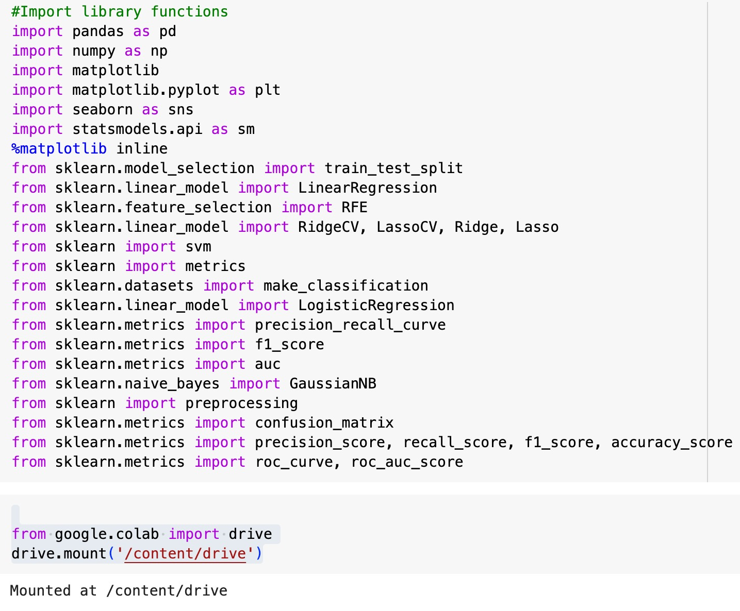
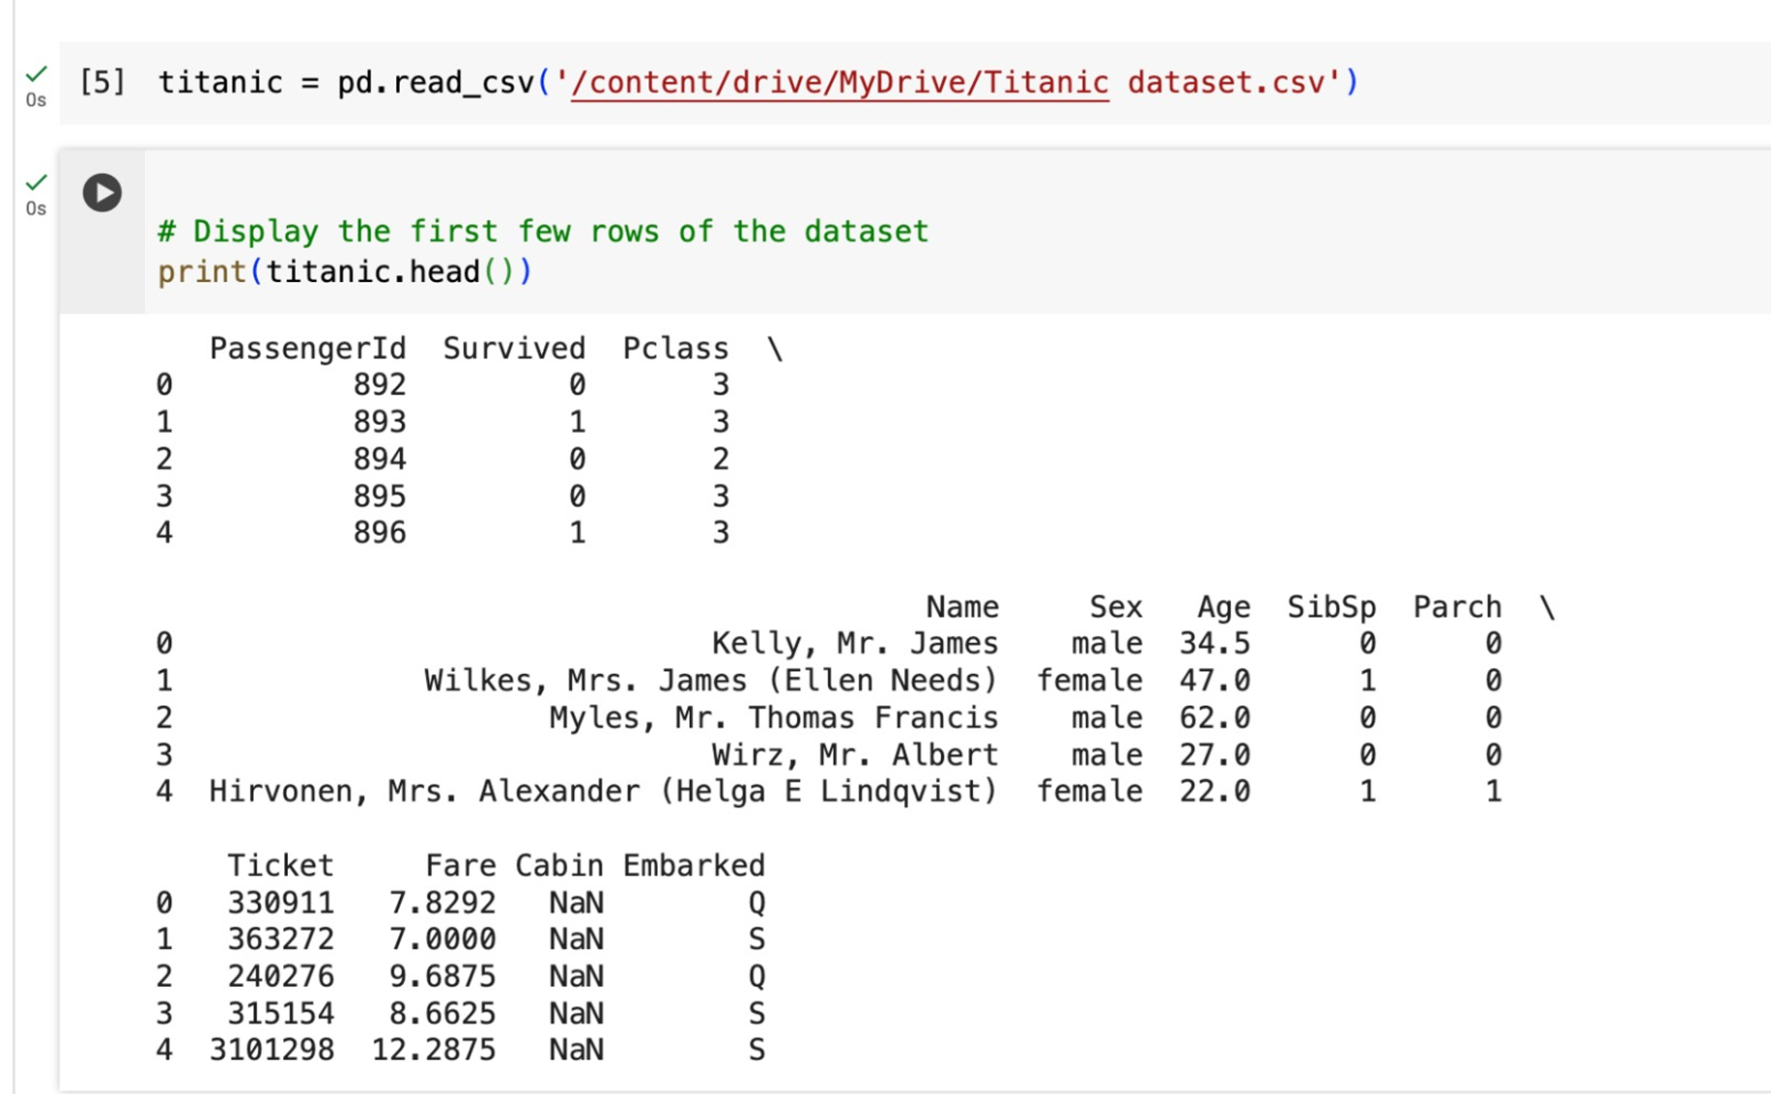
Import library :
Display some data:

Slide 5
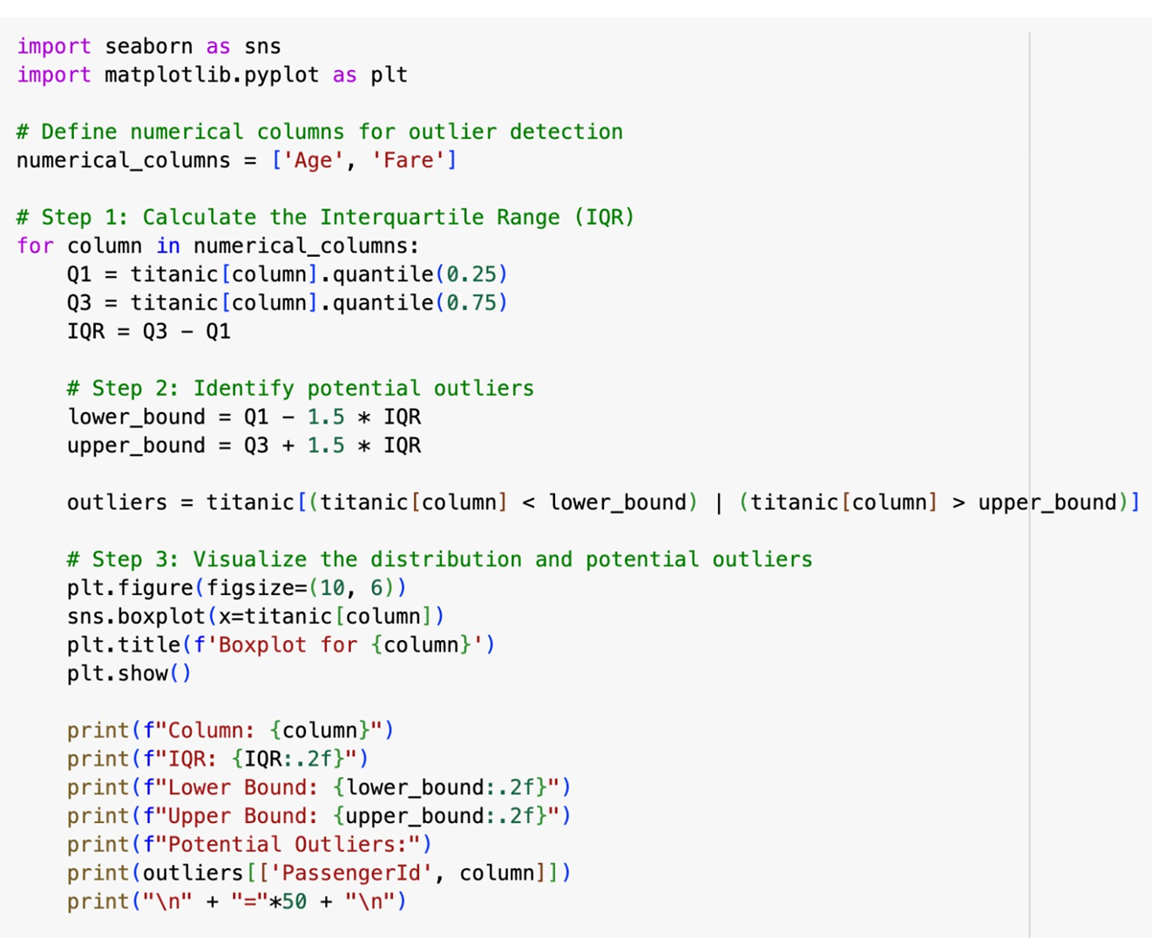
Outlier Code:

Slide 6
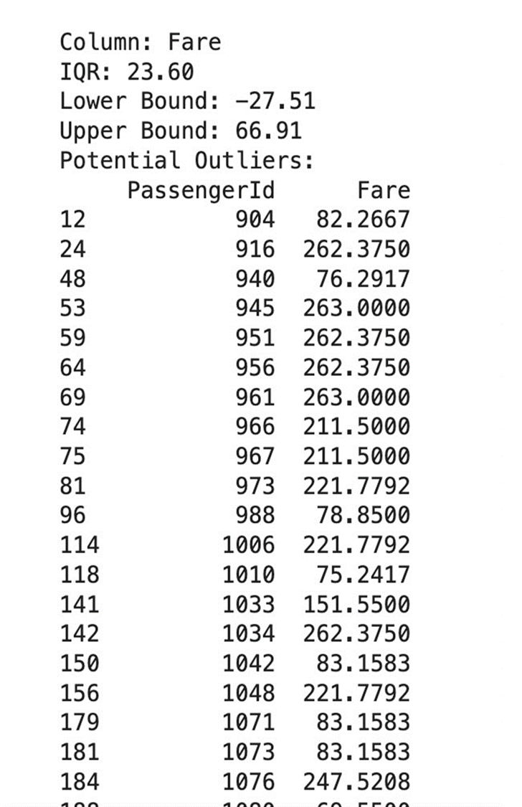
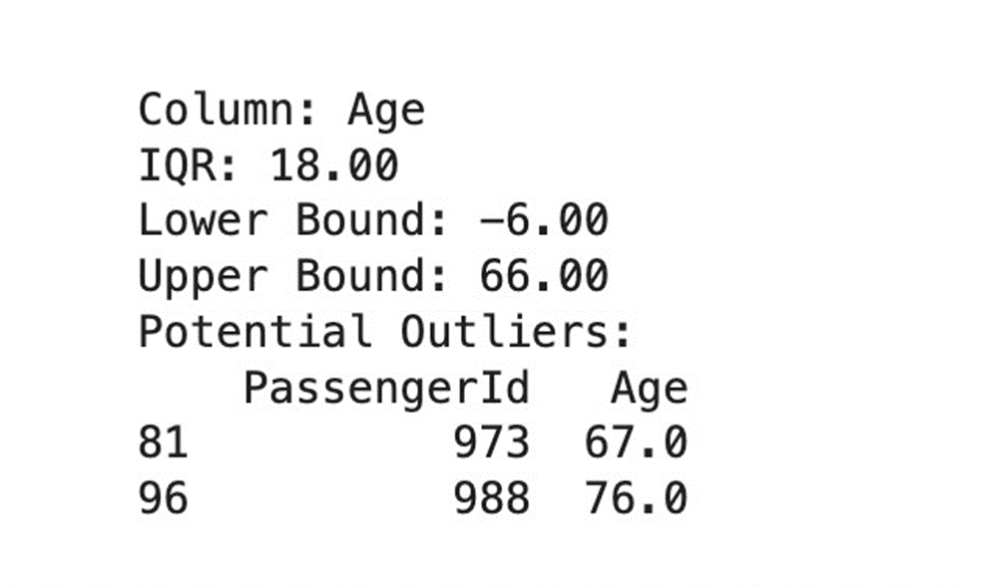
Output:

Slide 7
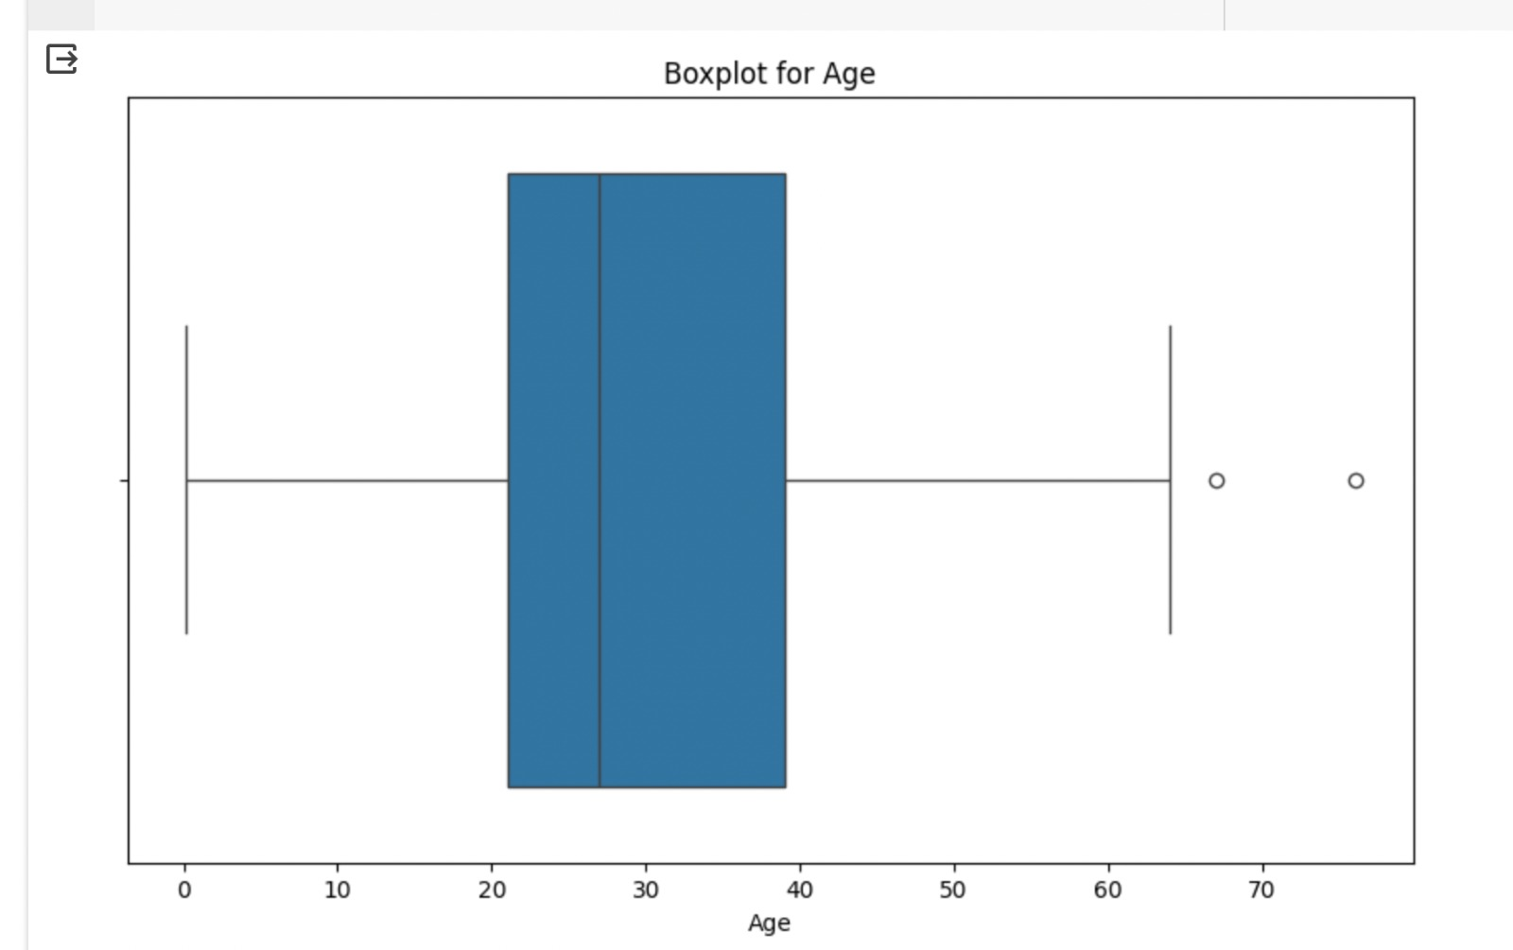
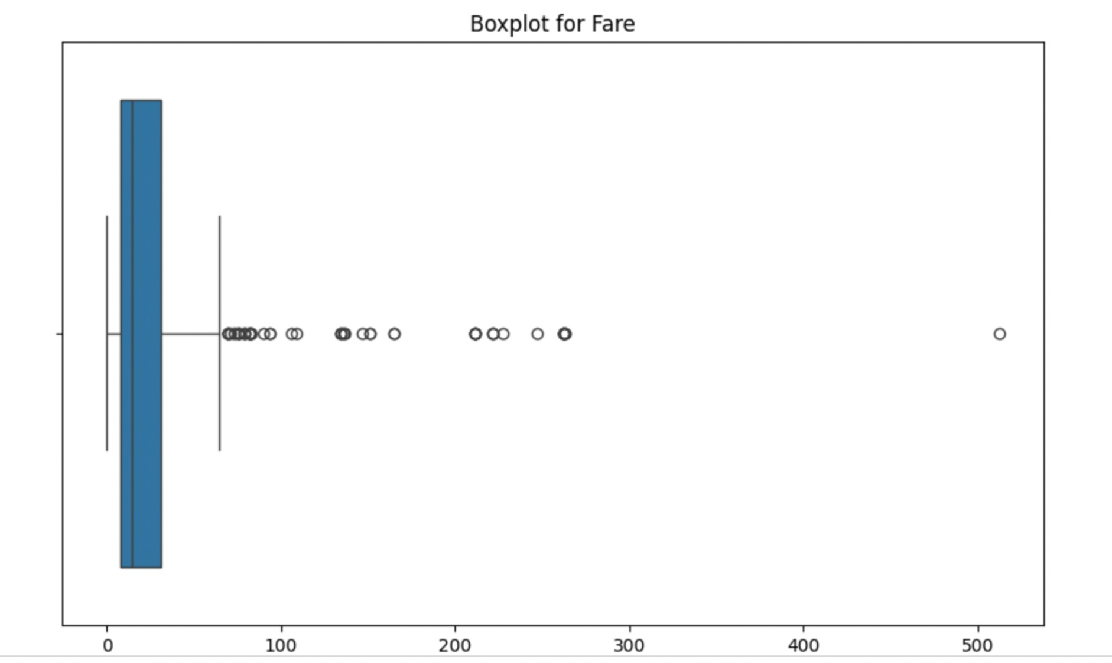
Boxplot for Age & Fare:

Slide 8
Interpret Results:
Outliers in Age Column:
IQR: 18.00
Lower Bound: -6.00
Upper Bound: 66.00
Potential Outliers:
Passenger Id 973:
Age: 67.0
Passenger Id 988:
Age: 76.0
Outliers in Fare Column:
IQR: 23.60
Lower Bound: -27.51
Upper Bound: 66.91
Multiple passengers with higher fares are identified as potential outliers.

Slide 9
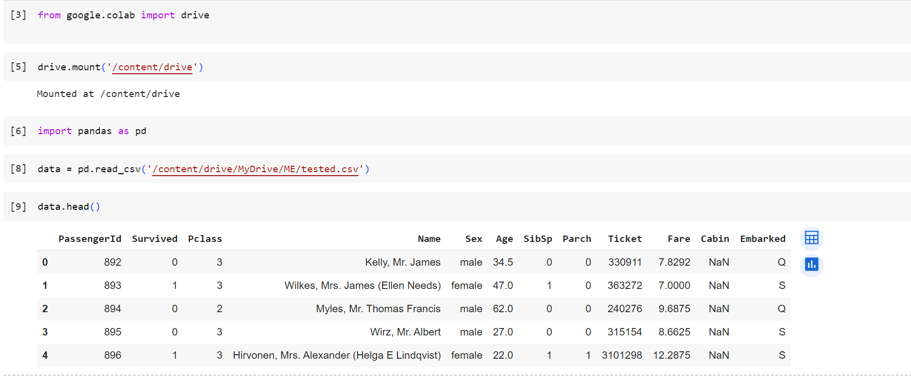
Correlation Finding :

Slide 10
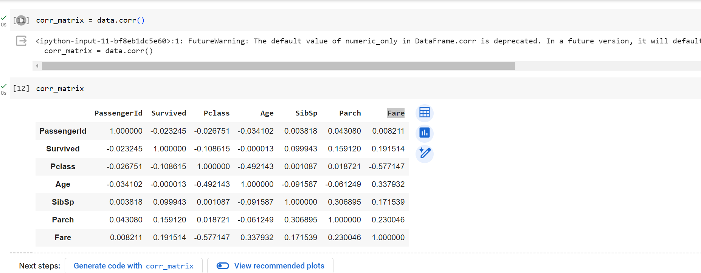
Find out Correlation matrix:

Slide 11
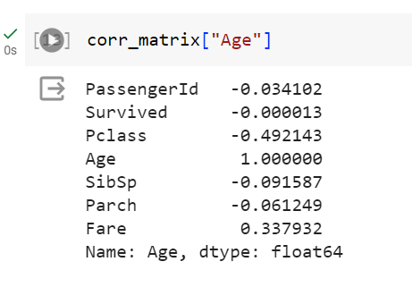
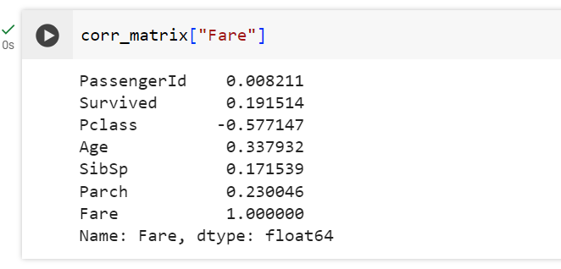
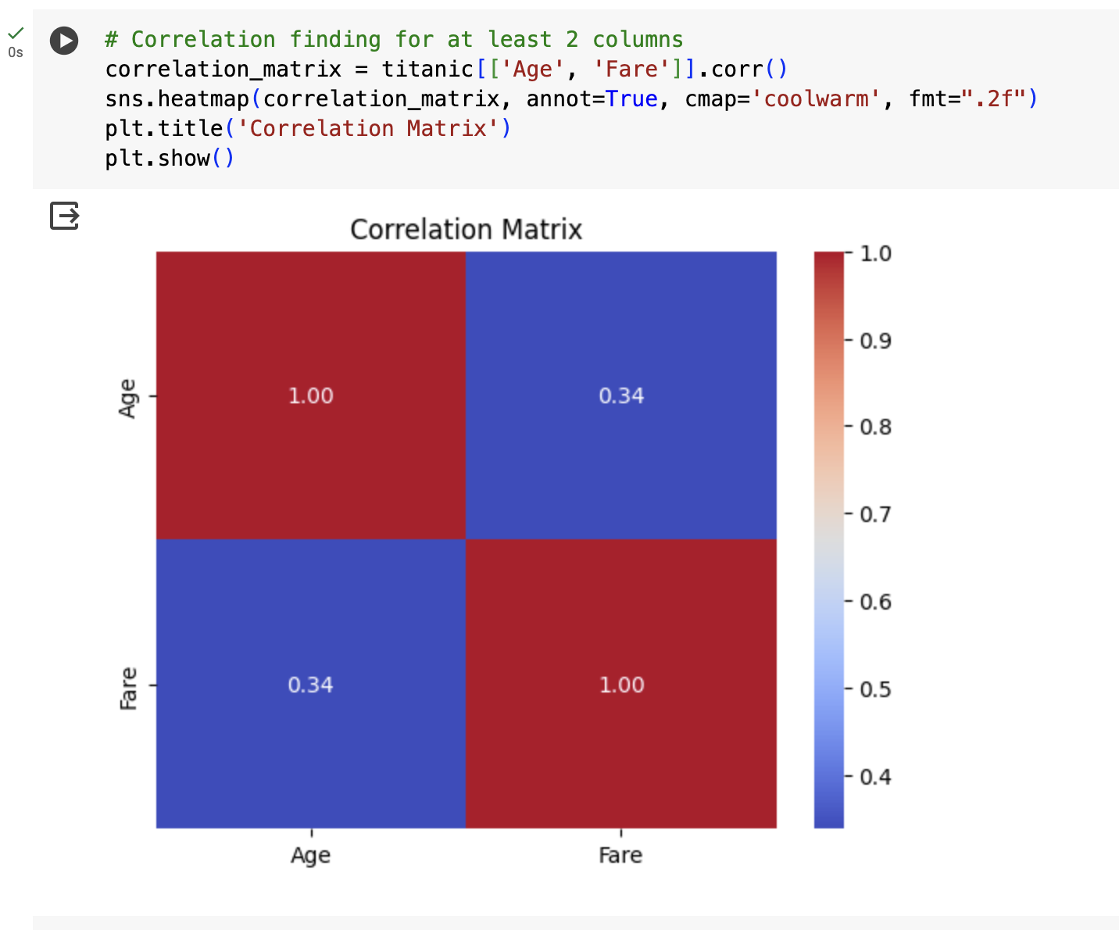
Output:

Slide 12
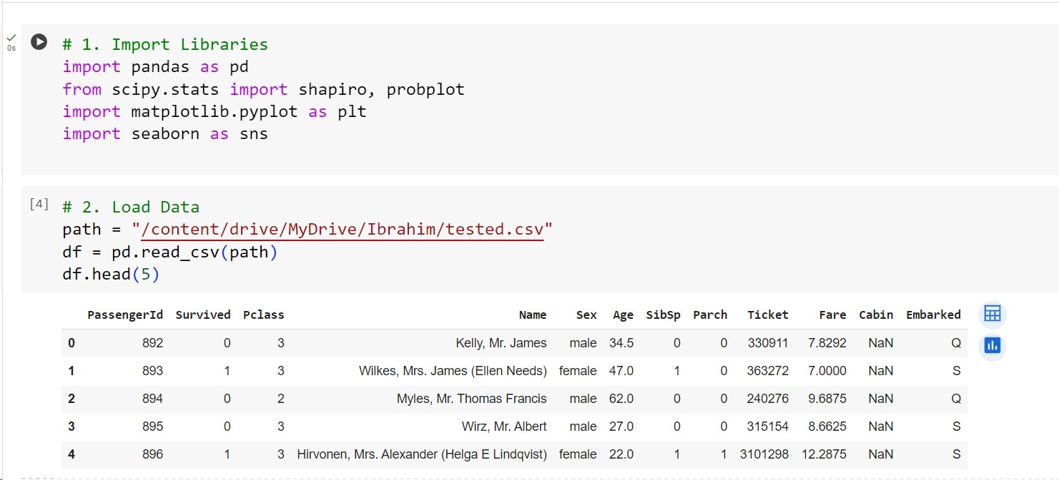

Slide 13
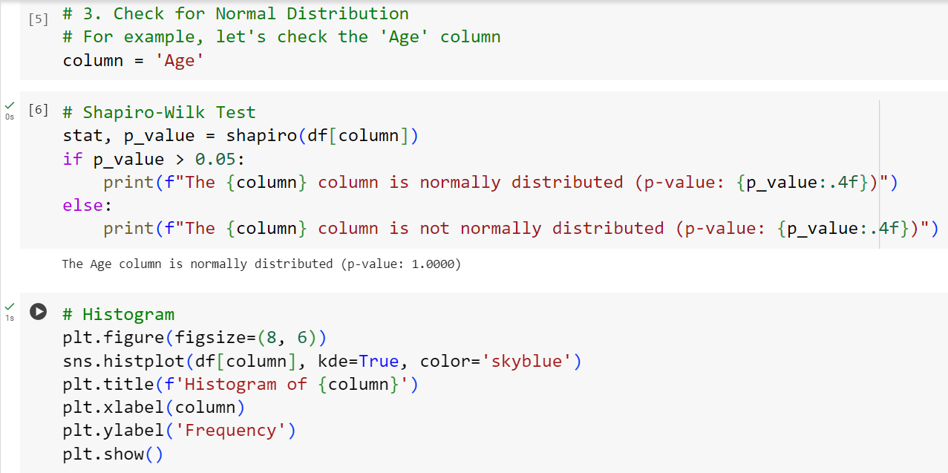
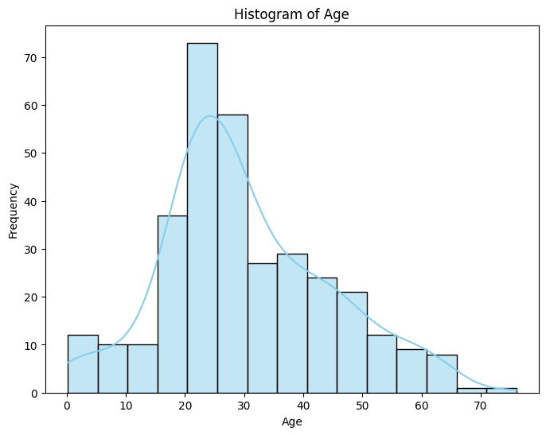
Check for Normal Distribution:

Slide 14
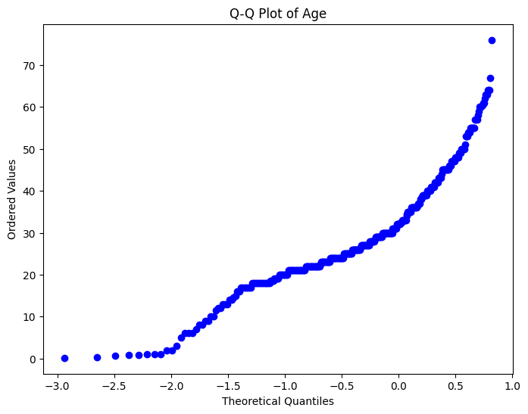
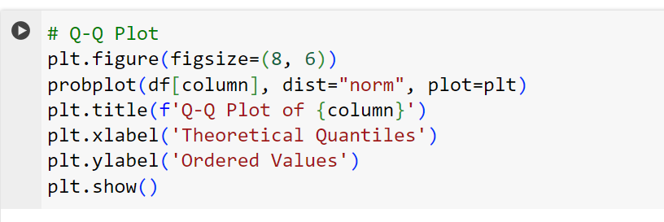

Slide 15
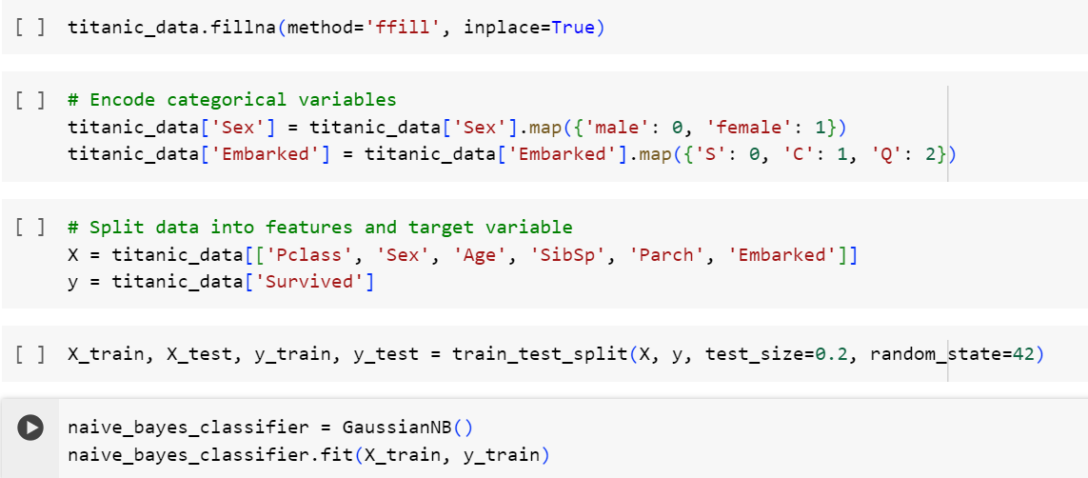
Apply Bayes Theorem:

Slide 16
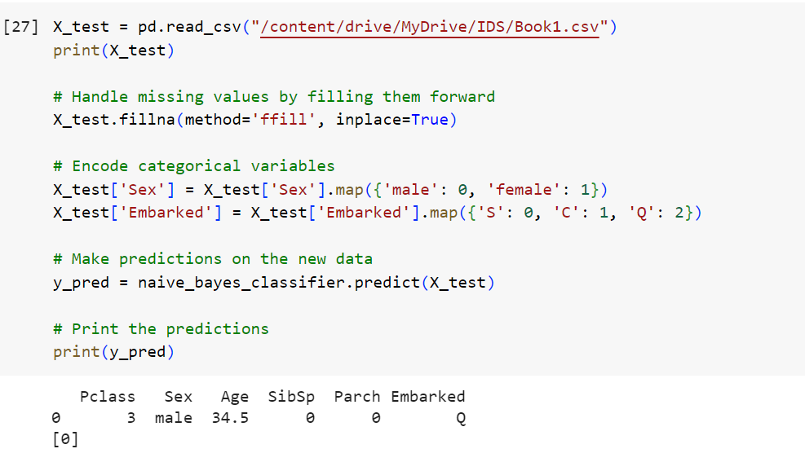
Predict (3,0,34.5,0,0,2)….

Slide 17
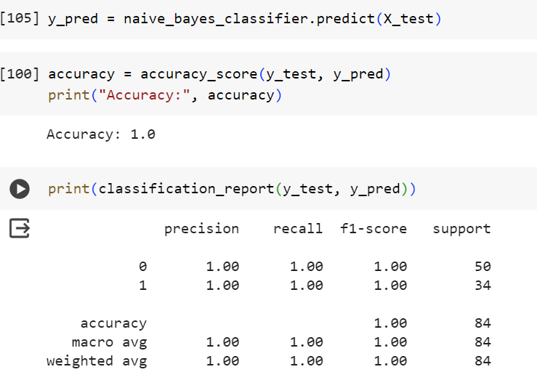
Accuracy
A precision of 1.00 indicates that all predictions for both classes were correct.
A recall of 1.00 indicates that the model correctly identified all instances of both classes.

Slide 18
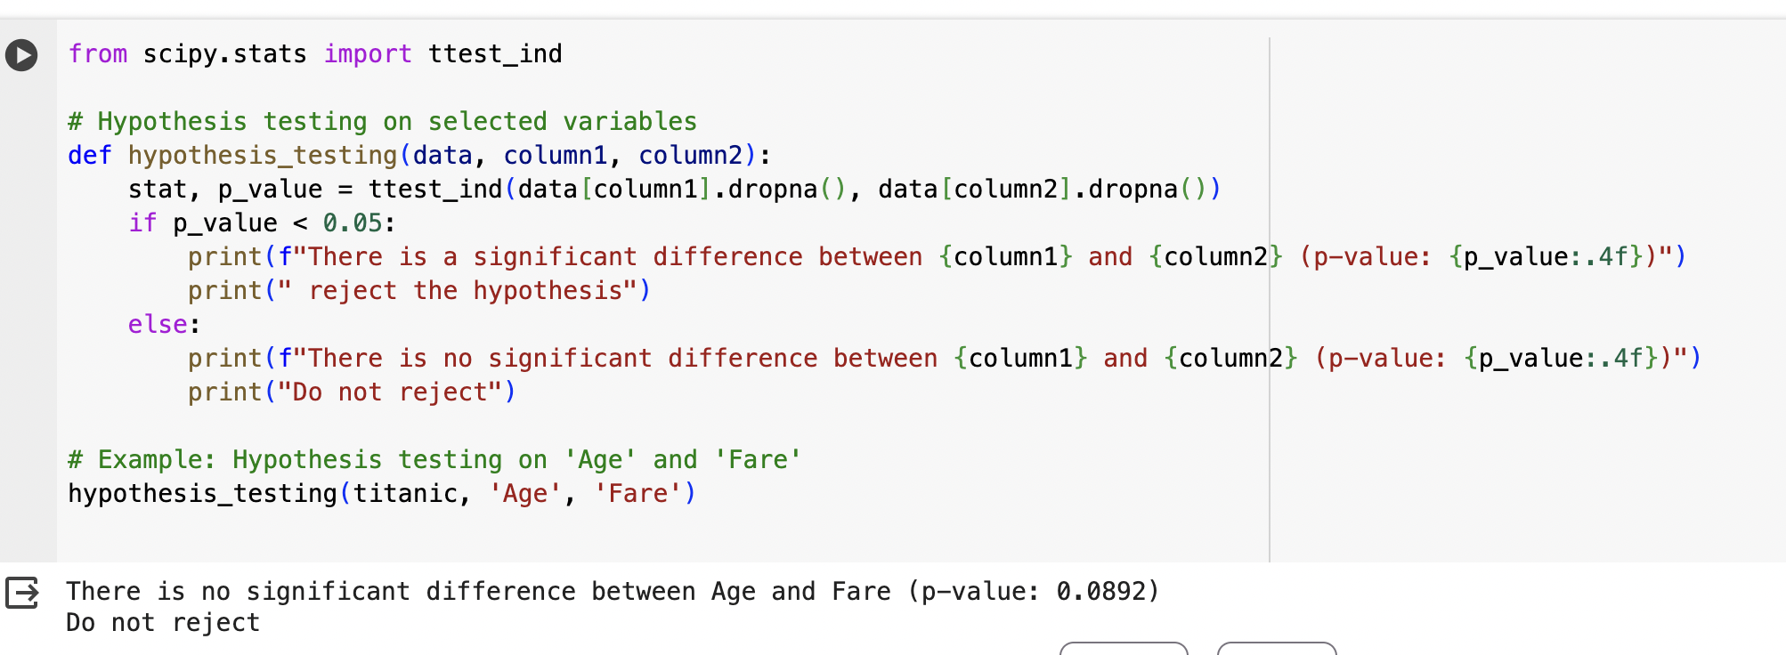
Hypothesis Testing:

